Slide 1
Managing Attachments
AWCTS/ARCS

Slide 2
Problem Statement
420 of the 450 GB of AWCTS data is ATTACHMENTS
Need to limit future database bloat
As of 17 April 2021, AWCTS will limit attachment document size to 2MB

Slide 3
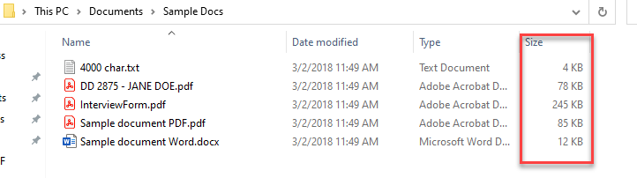
File size
Ensure settings on your scanner are less than 300dpi
Aim for file size < 1MB
  File explorer
  Properties (right click and select “Properties”)

Slide 4
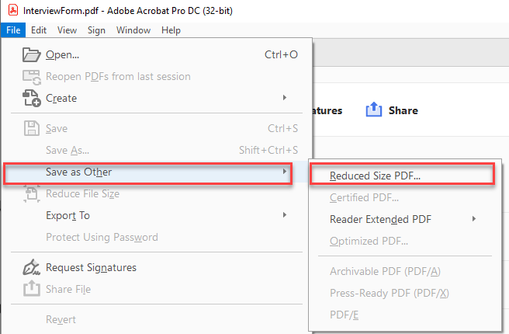
Reducing file size - Acrobat
In Adobe Acrobat use Save as Other – Reduced Size PDF

Slide 5
Reducing file size if PDF too large
For large files that can’t be reduced enough using the Reduced Size function
  Save as JPG
    In Acrobat, Save As
    Select JPG as file type
    Click “Settings”
    Select Minimum quality for gray scale and color
  Locate .JPG in files and open
  Save back to PDF

Slide 6
Reducing file size - photos
Save file as .PNG
Save .PNG file as .PDF
Use reduce Size PDF to reduce file size further

Slide 7


Closing Comments

